Slide 1
Cloud Computing and Big Data
Consensus

Slide 2
Fundamental problems in Distributed Computing
Efficient distribution of work
combating serialization
Consensus
combating failure

Slide 3
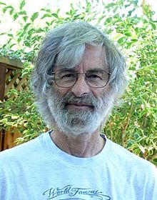
Leslie Lamport

Slide 4
Consensus
In almost any cluster of machines
Spark, Kafka, Cassandra, etc
We need:
A consistent configuration
(often) A controller
The controller may fail
Therefore we need to be able to detect that and elect a new leader/controller
“Crash Fault Tolerance”

Slide 5


Slide 6
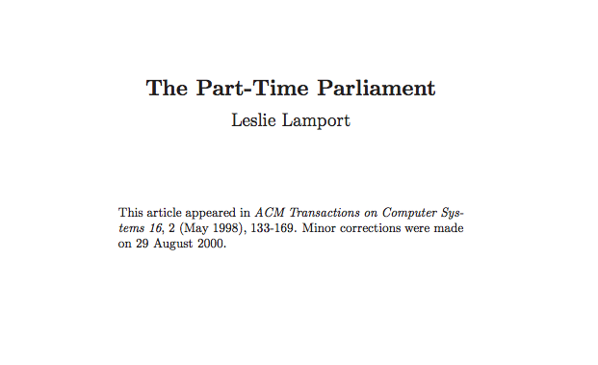

Slide 7
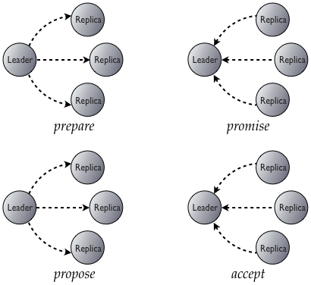

Slide 8
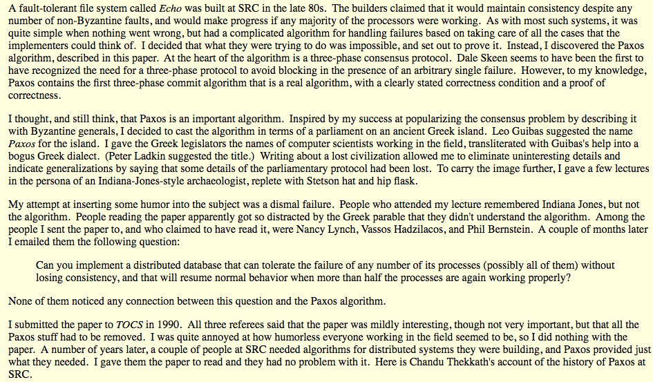

Slide 9
Paxos in production
Cassandra uses Paxos for leadership election
Google Chubby (distributed lock service) and hence BigTable
Google Spanner and Megastore
OpenReplica
IBM SAN Volume Controller
Microsoft Autopilot cluster management
WANdisco have implemented Paxos within DConE
XtreemFS uses a Paxos-based lease negotiation algorithm
Heroku uses Doozerd consistent distributed data store.
Ceph uses Paxos
The Clustrix distributed SQL database uses Paxos for distributed transaction resolution.
Neo4j HA graph database Paxos, replacing ZooKeeper

Slide 10
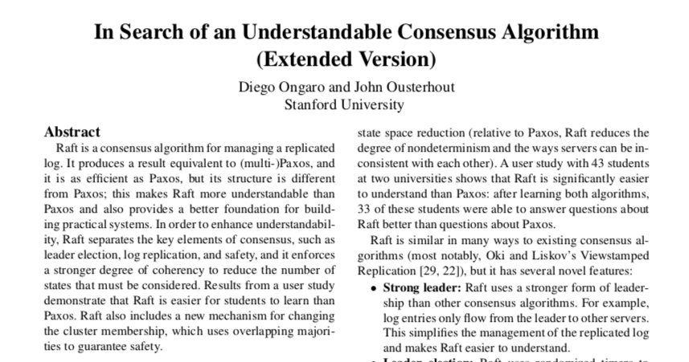
Raft

Slide 11
Raft consists of two main parts
Leadership elections
Creating a consistent log once a leader is in place

Slide 12
Raft Key concepts
Leader
The leader ingests new log entries, distributes to peers and decides when they are commited.
Quorum
(n mod 2)+1 members, where n is the size of the peer set
Peer Set
The set of nodes participating
Committed Entry
An entry is committed if it is stored persistently on a quorum of nodes. Then it can be applied.
Log
The log is consistent iff all participants agree on the entries and the order
Finite State Machine
A Finite State Machine is well defined set of states and transitions. Ensures that each peer applying the same logs reaches the same conclusions

Slide 13
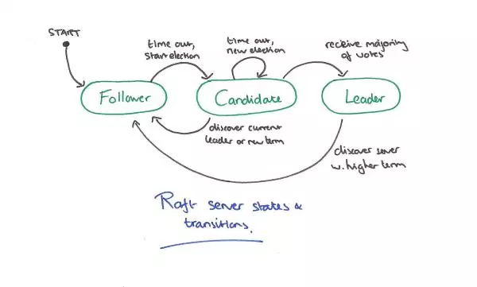
Raft Leadership Election
https://blog.acolyer.org/2015/03/12/in-search-of-an-understandable-consensus-algorithm/

Slide 14
Once a leader is in place
Client requests the leader writes a log entry
The leader writes it to durable storage
Replicates to a quorum of followers
Once the log entry is committed, it can be applied
Execute the FSM with the new data

Slide 15
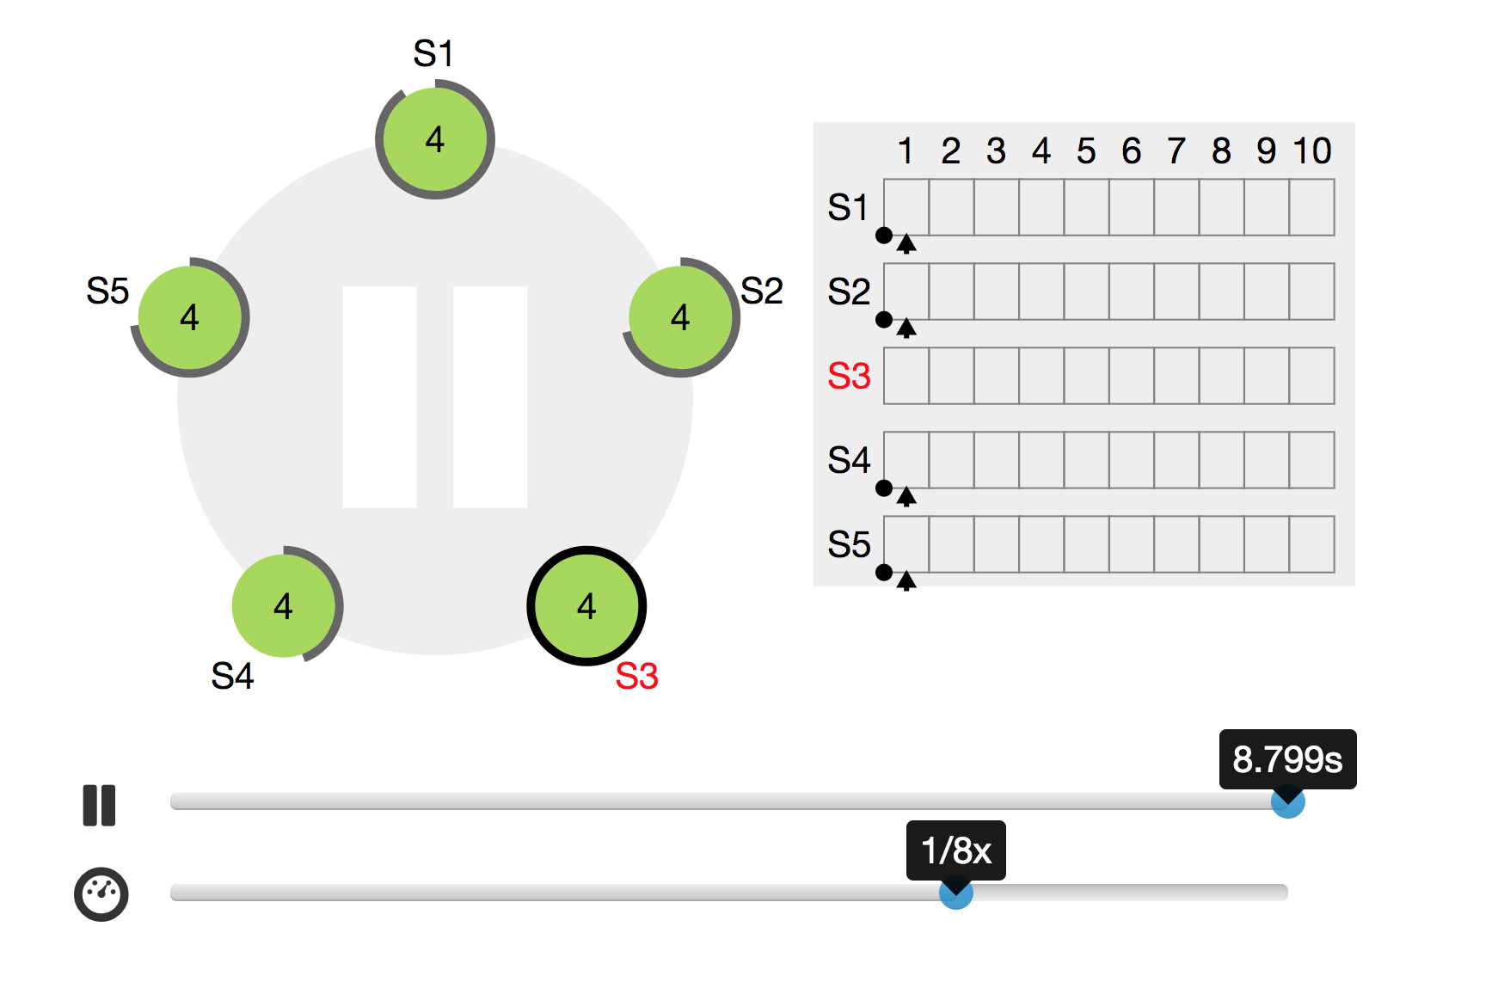
Nice visualisations of Raft
http://thesecretlivesofdata.com/raft/
https://raft.github.io/

Slide 16
Implementations / Users of Raft
etcd
Consul
TiKV
OpenDaylight Controller
CopyCat from Atomix
JGroups

Slide 17
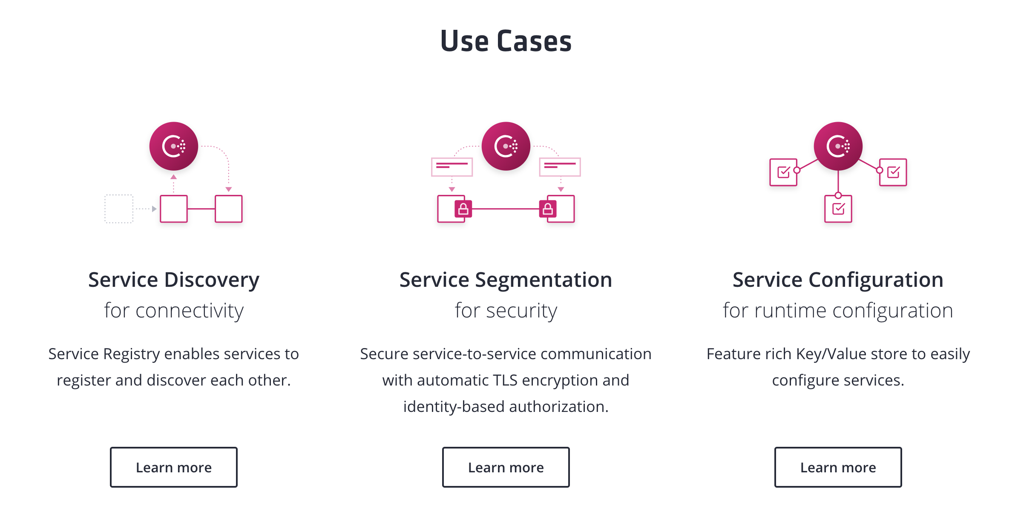
Consul

Slide 18
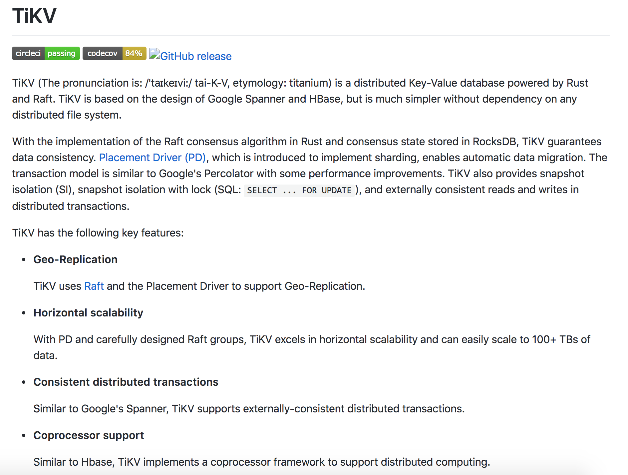

Slide 19
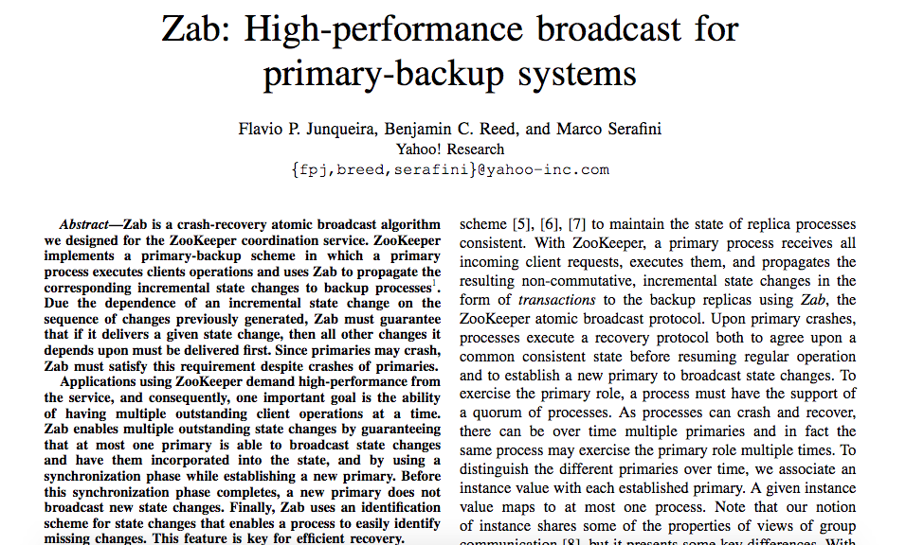

Slide 20
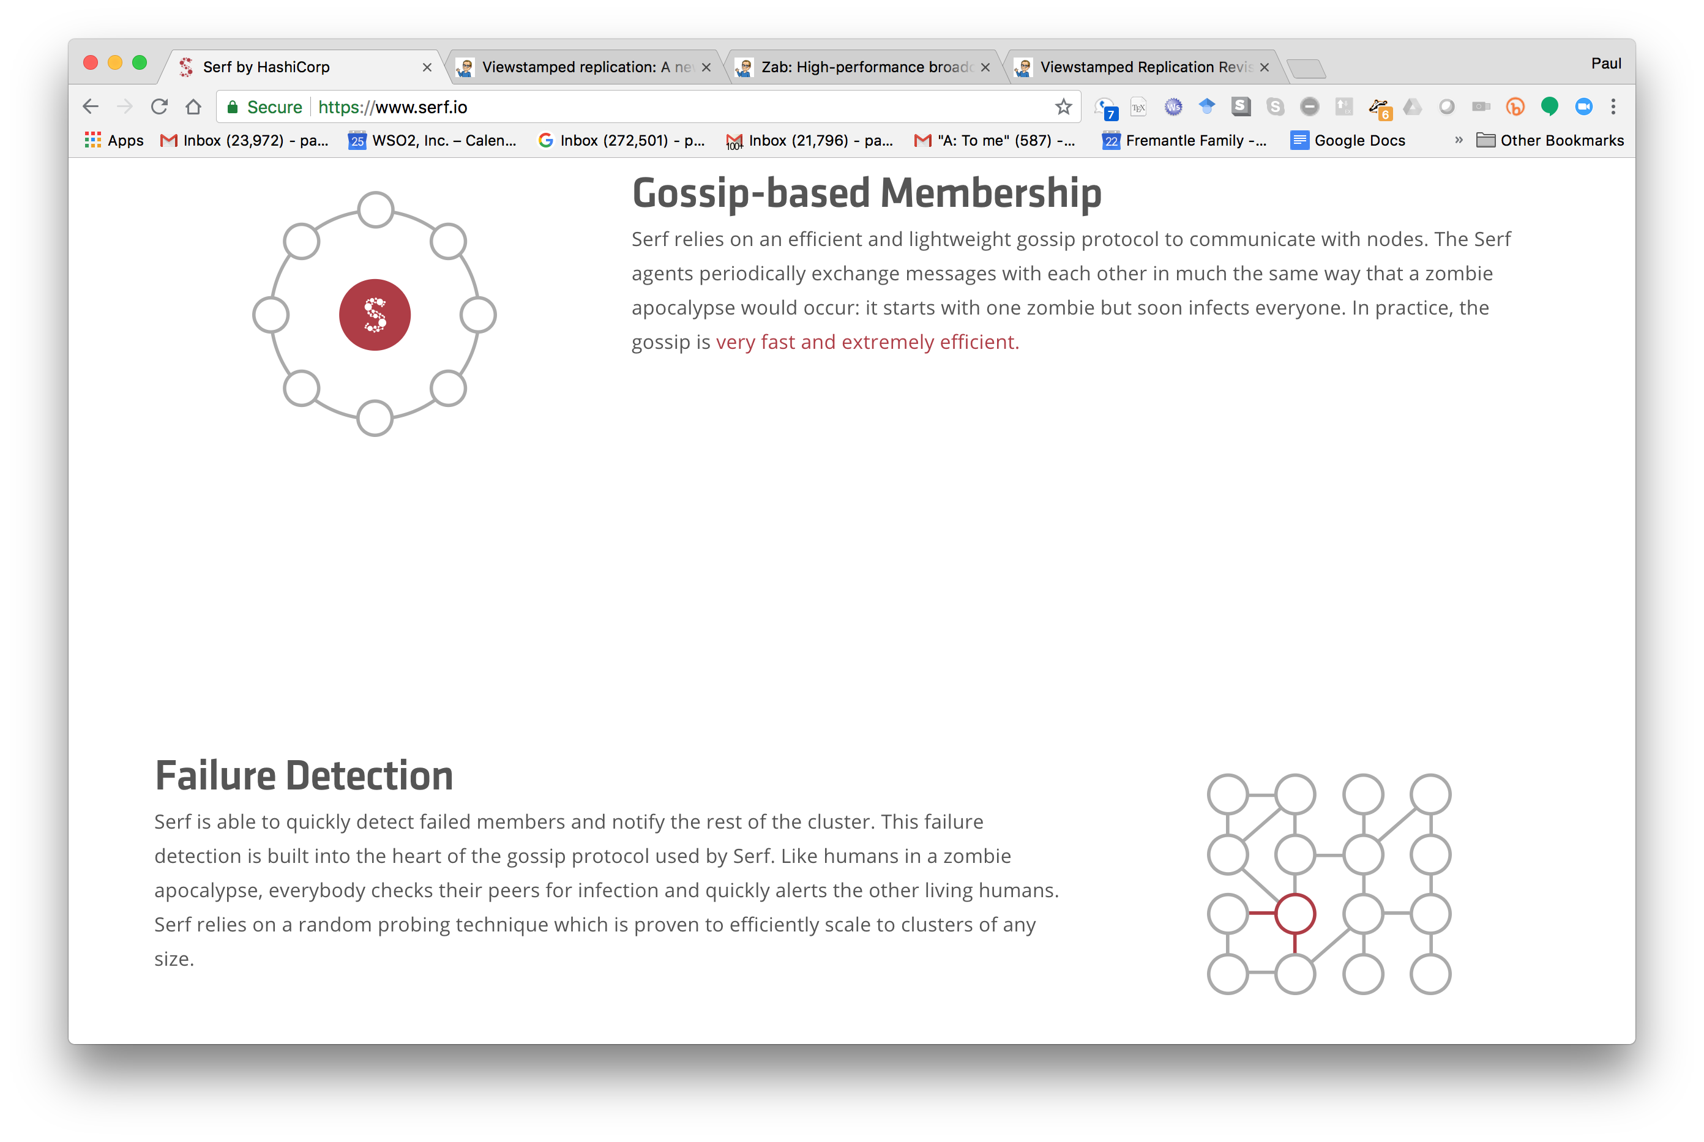
Serf.io

Slide 21
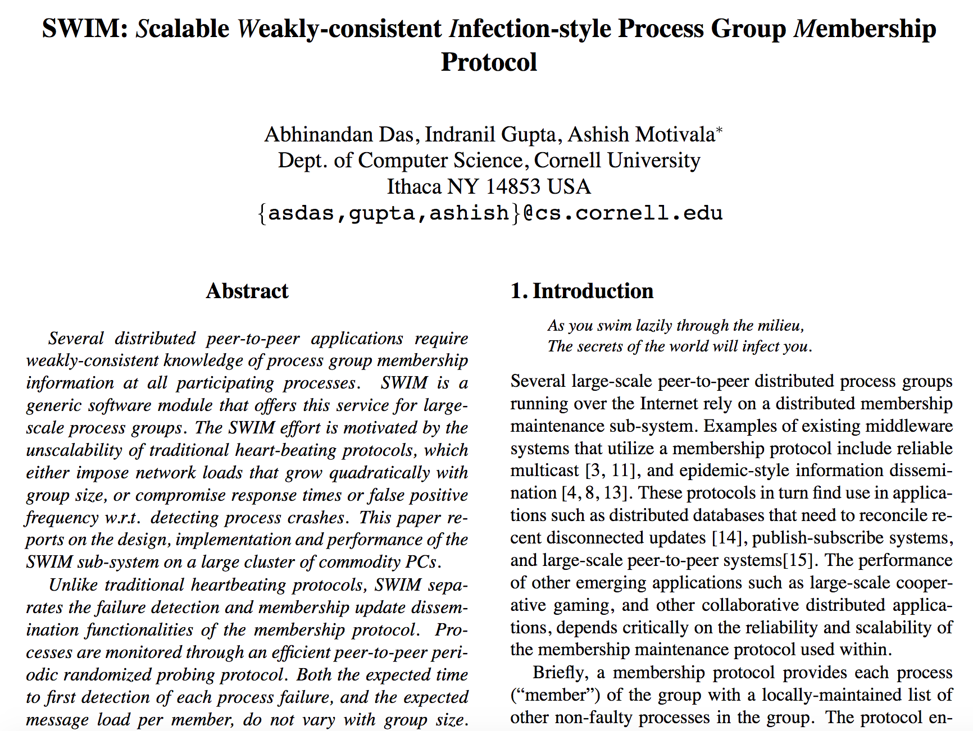

Slide 22
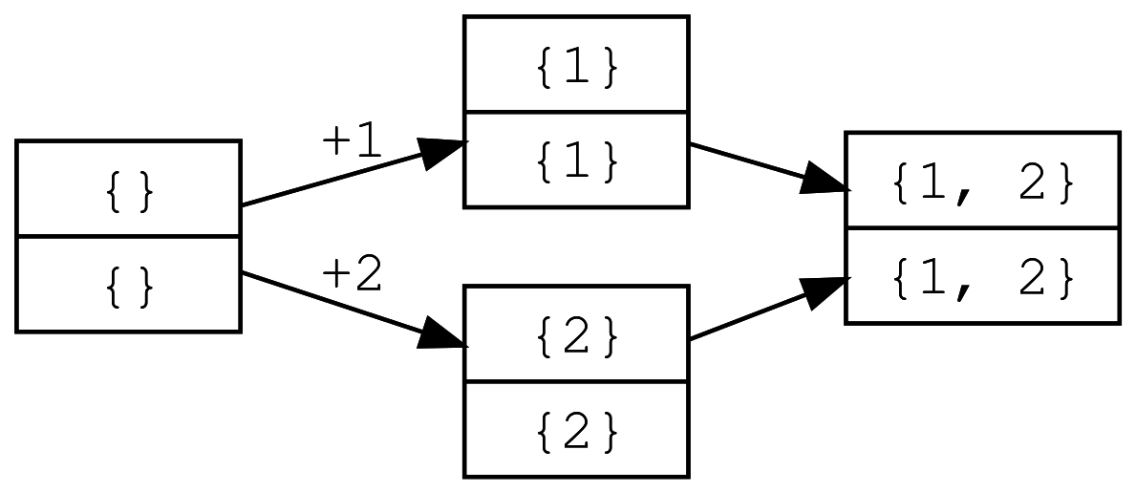
Conflict-free Replicated Data Types
Also known as {Commutative, Convergent, Confluent}

Slide 23
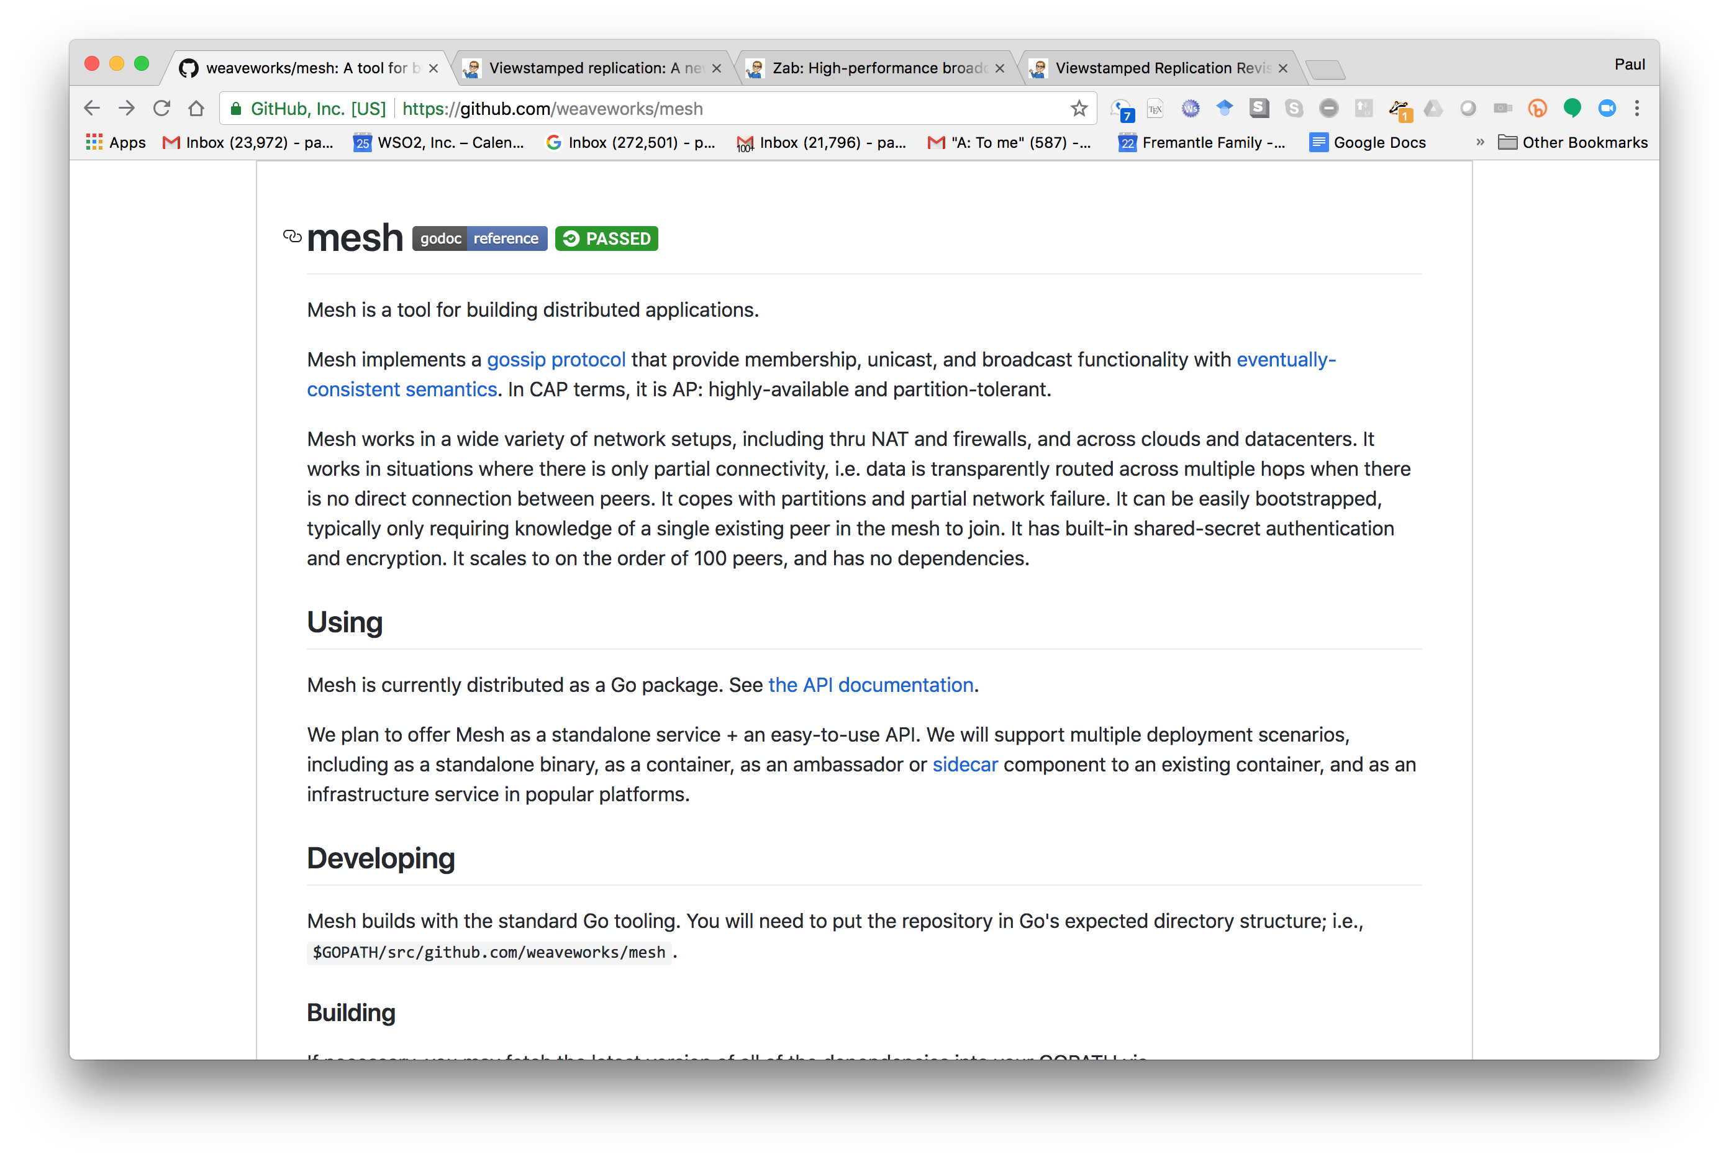

Slide 24
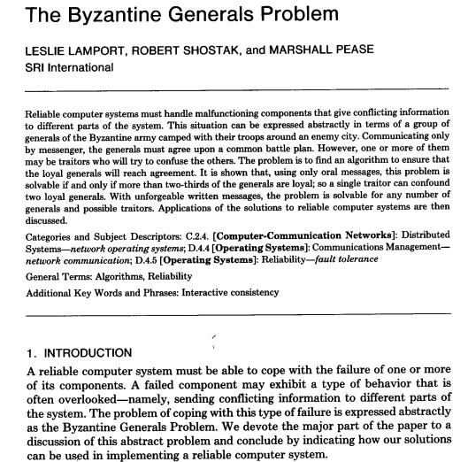

Slide 25
Byzantine failures
A Byzantine fault is any fault presenting different symptoms to different observers.
Imagine a set of generals trying to formulate a plan
Some of the generals are traitors
They may lie to other generals
They may lie selectively

Slide 26
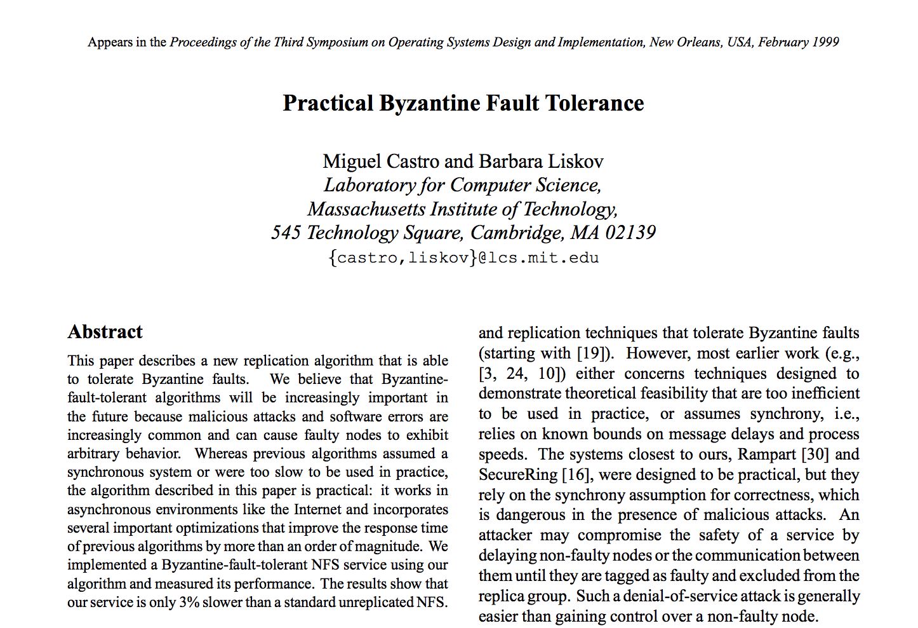

Slide 27
Summary
Distributed consensus algorithms existed since the 1990s
More recently gaining traction
A key part of big data systems
Leadership election
Consistent configuration

